Slide 1
Train System Demonstration
By: The Conductors
Designers: Bryan, Ethan, Jarrod, Justin, Paul, Owen, Patrick, and Mac

Slide 2
Summary
Overview
Advertisement
Cost Analysis
Estimated vs. Actual Hours
Bug Report
Lessons Learned
What to do differently?

Slide 3
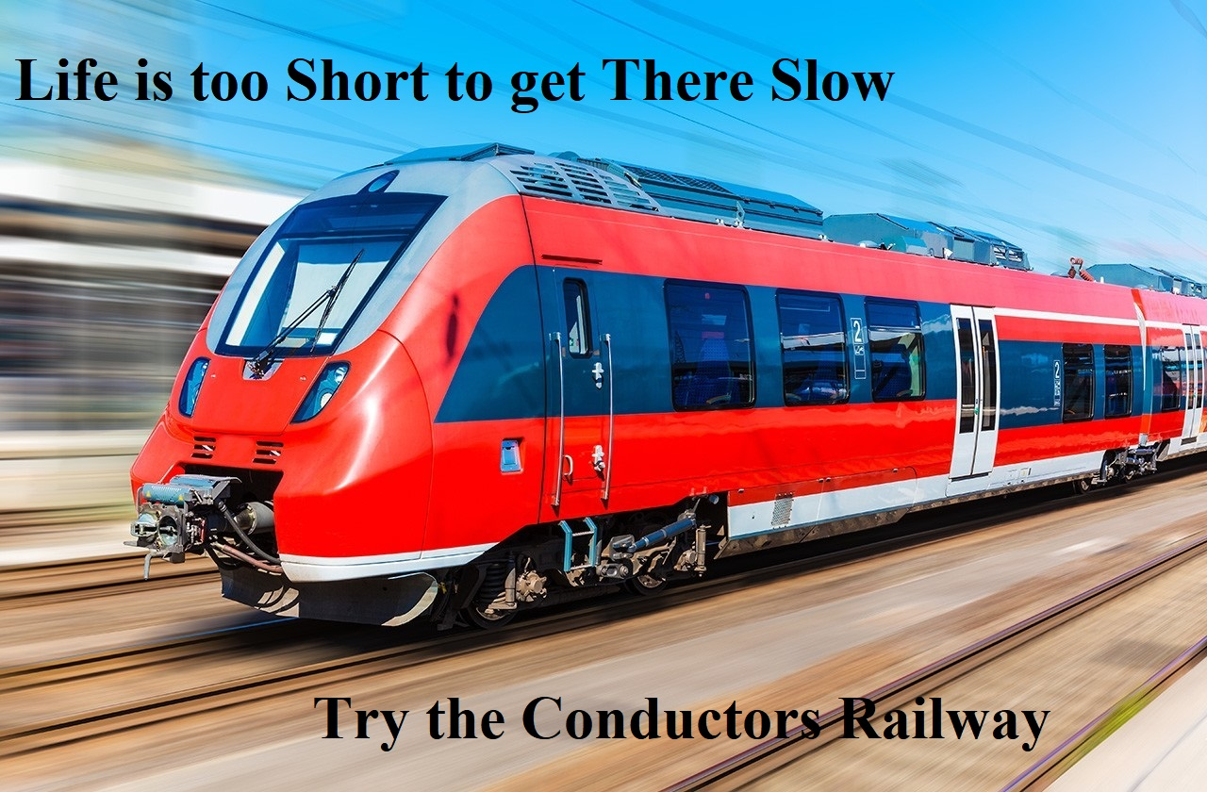
Advertisement

Slide 4
Help Doc
Installation/Startup Instructions
Download and run installer in ECE1140_Conductors GitHub
Navigate to Conductors_TrainSystem folder on desktop
Run the executable in the folder to start the system

Slide 5
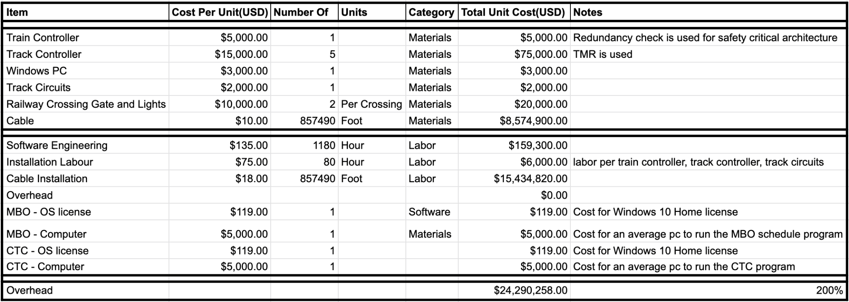
Cost Analysis

Slide 6
Estimated Hours vs. Actual Hours
Owen Fay: 120 hours
Paul Pei: 120 hours
Matthew Meehan: 120 hours
Justin Harnishfeger: 120 hours
Bryan Hess: 120 hours
Ethan Vukelich: 120 hours
Jarrod Frost: 120 hours
Patrick Deiger: 120 hours
Total Team: 960 hours
Owen Fay: ~140 hours
Paul Pei: ~150 hours
Matthew Meehan: ~145 hours
Justin Harnishfeger: ~180 hours
Bryan Hess: ~180 hours
Ethan Vukelich: ~140 hours
Jarrod Frost: ~125 hours
Patrick Deiger: ~140 hours
Total Team: ~1180 hours

Slide 7
Bug Report
Bugs peaked in frequency towards the end of the project.
Last 4 weeks of our project:
Week 1: 2 per Module = ~16 bugs
Week 2: 2 per Module = ~16 bugs
Week 3: ~14 bugs
Week 4: ~35 bugs
Notable bugs:
3.5: Switching Not Affecting CTC
9.1: Left Side Integration issues
9.3: Right Side Integration issues
7.5: Train is Blowing past Stations

Slide 8
Biggest Lessons Learned?
Integration takes longer than expected
Make realistic deadlines and if they are not met, re-evaluate deadlines
Don’t try to take on too much at once

Slide 9
What we would do differently second time around
Start integration earlier
Design system as a team from beginning to end so that integration is spread throughout semester
Make sure everyone is using the same version of QT and that it is compatible with Arduino
Test all module UIs on multiple devices
Work on QT signals much earlier
Rigorous unit testing before and after integration step
Clarify requirements ahead of time amongst ourselves

